Slide 1
Shape Rhythms
Bradford Music & Arts Service

Slide 3
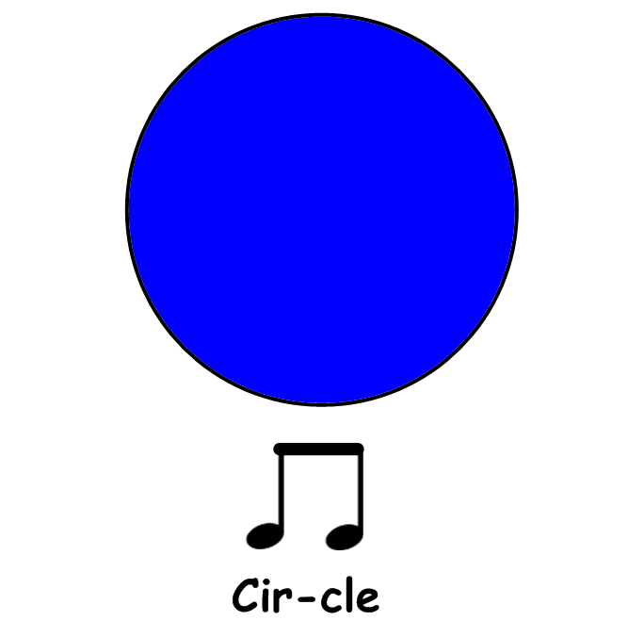

Slide 4
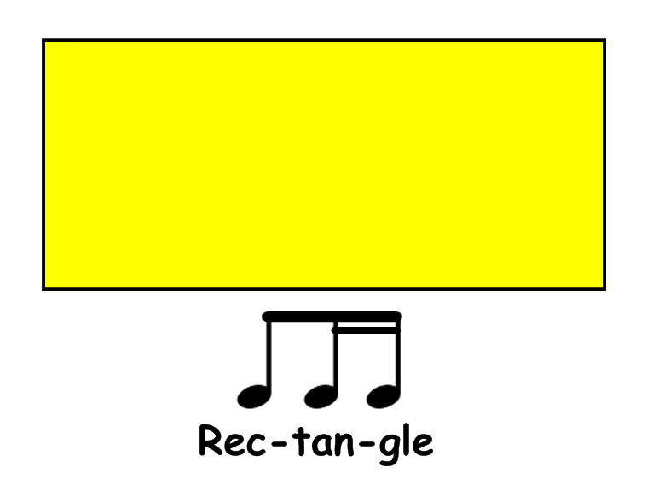

Slide 5
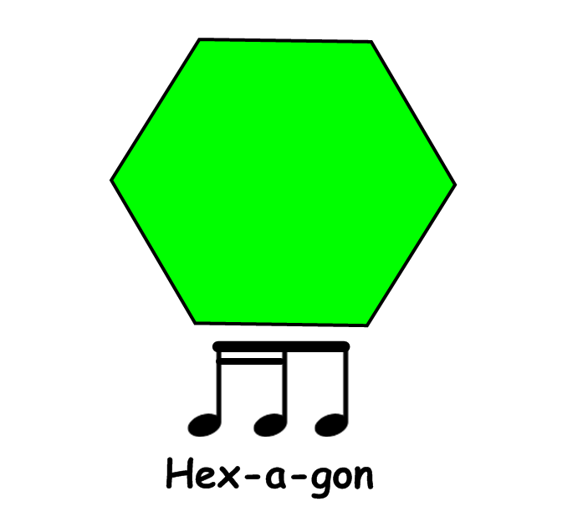

Slide 6
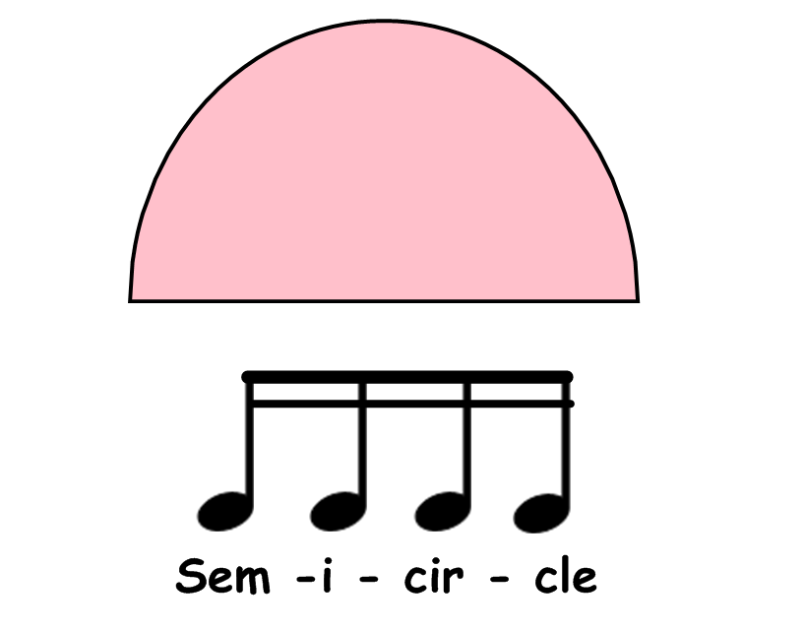

Slide 17
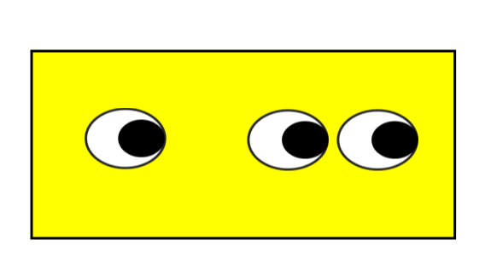

Slide 28
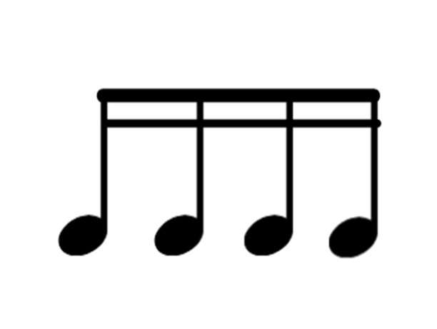

Slide 37
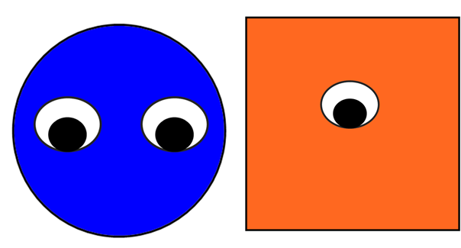

Slide 45
The shapes on this slide can be copied to create you own flash cards
and additional resources.

Slide 46
The notes and rhythms on this slide can be copied to create you own flash cards
and additional resources.

