Slide 1
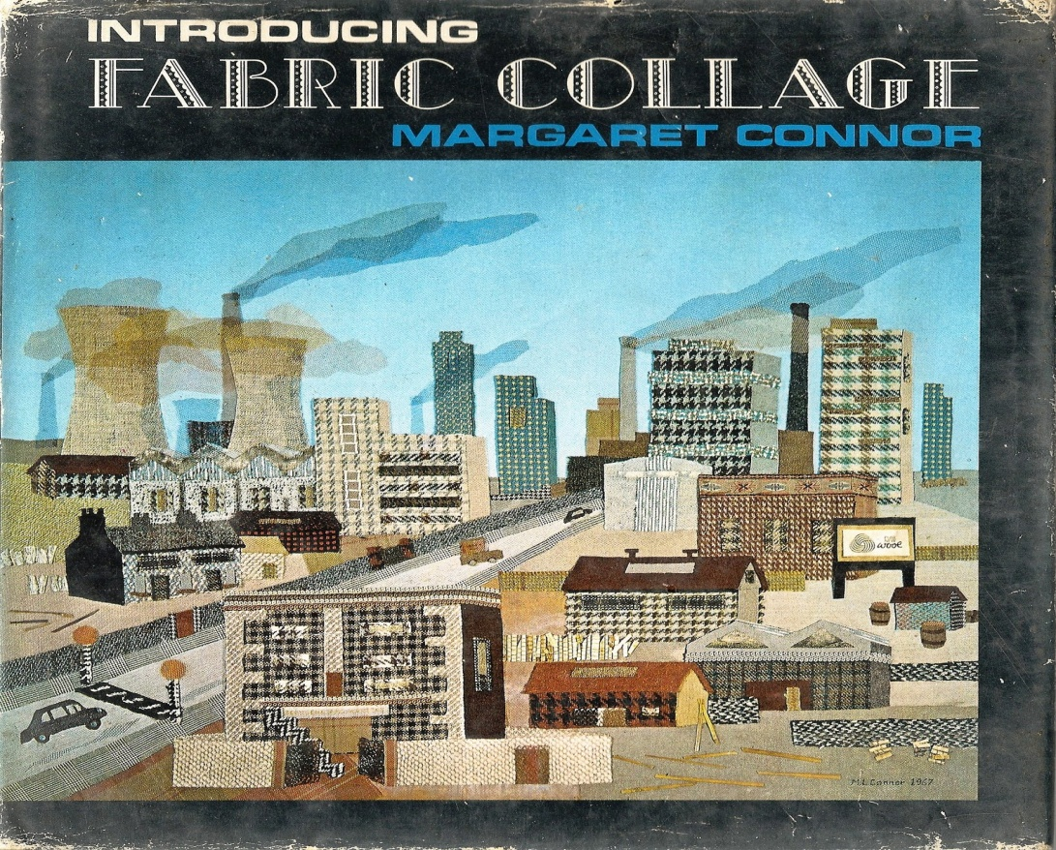
Margaret Connor was a talented Leeds needlecraft and fabric collage artist.
She taught in Leeds schools as well as publishing books on fabric collage and collections of poetry.
Sadly she died in 2013 but her legacy lives on as she kindly bequeathed some of her stunning and varied artwork to the Music & Arts Service.
If your school is interested in borrowing the collection for either exhibition or educational purposes, please contact Tony Bullock at anthony.bullock@bradford.gov.uk
A catalogue of her wonderful work follows here.

Slide 2
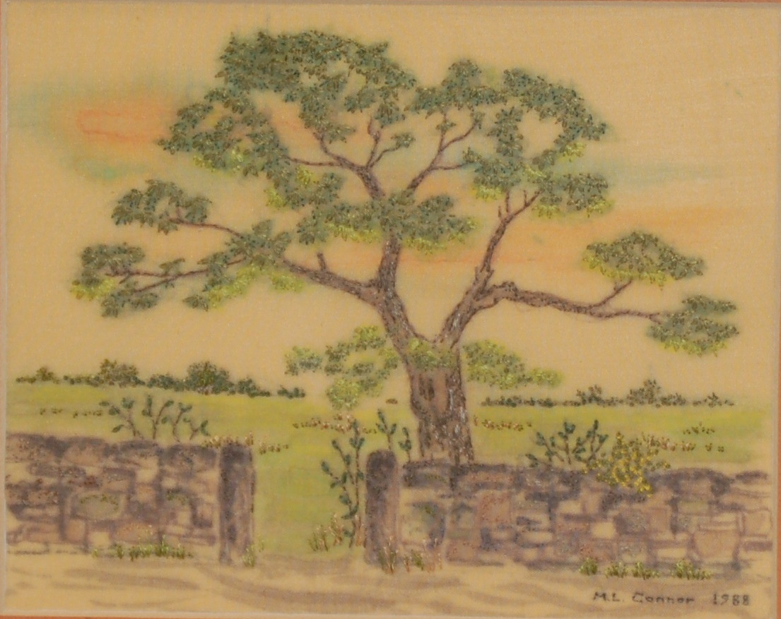

Slide 3
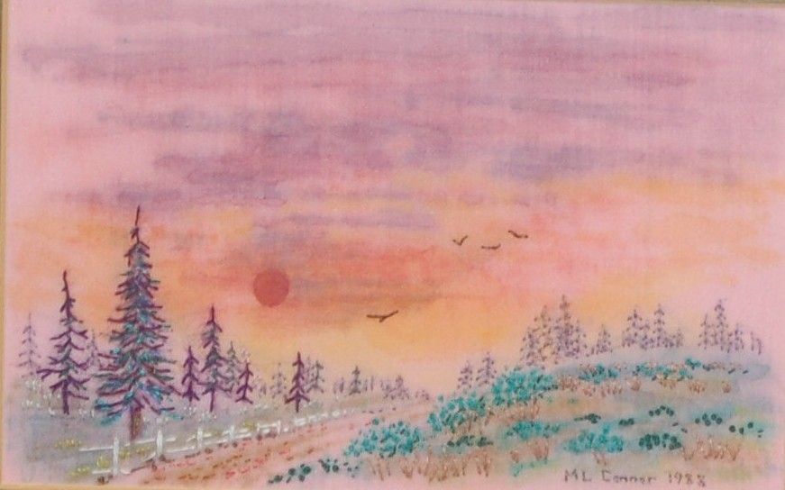

Slide 4
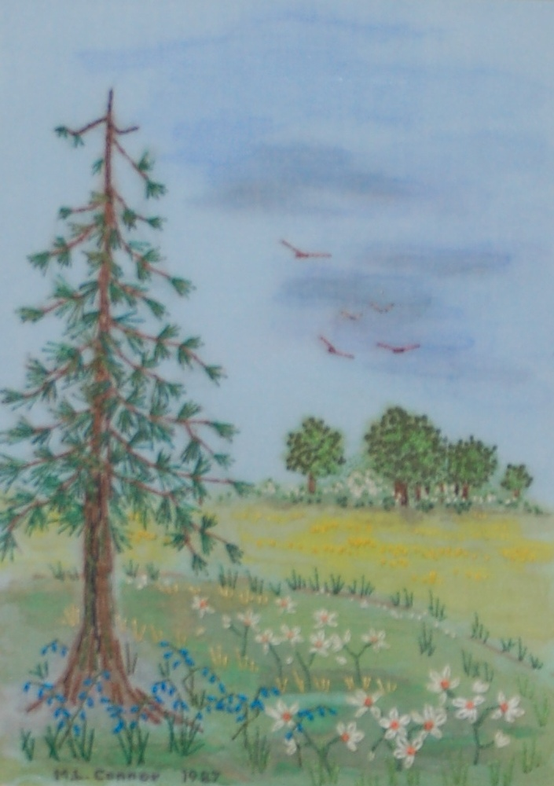

Slide 5
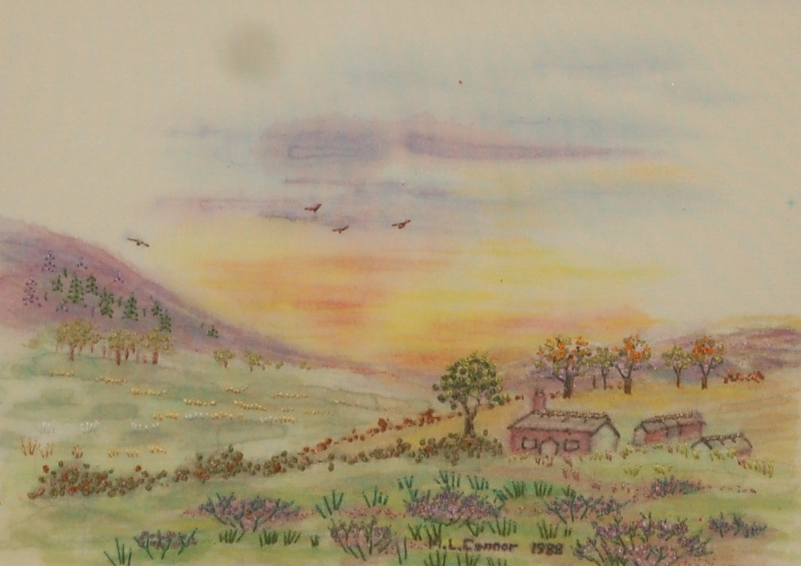

Slide 6
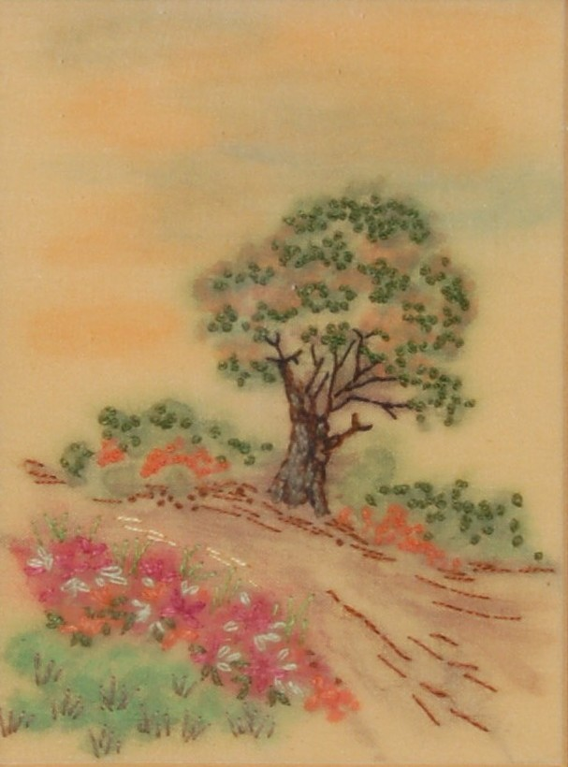

Slide 7
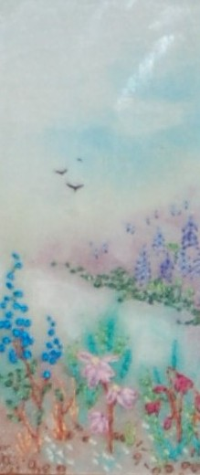

Slide 8
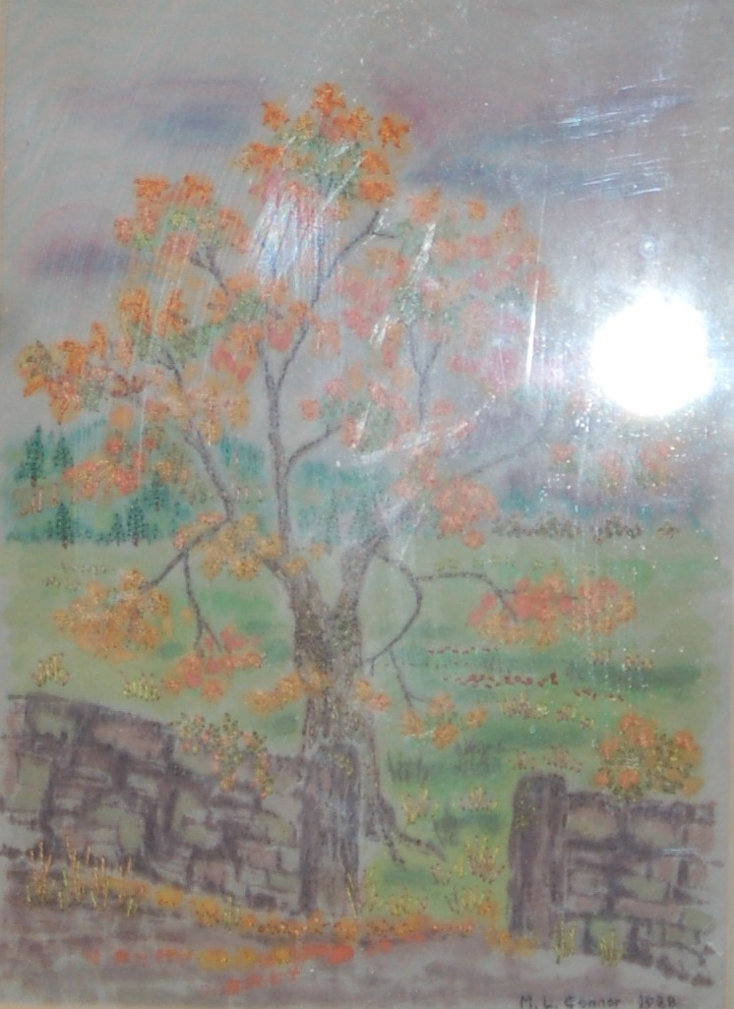

Slide 9
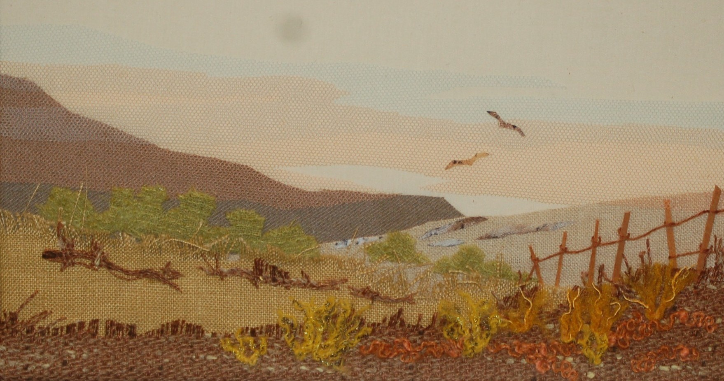

Slide 10
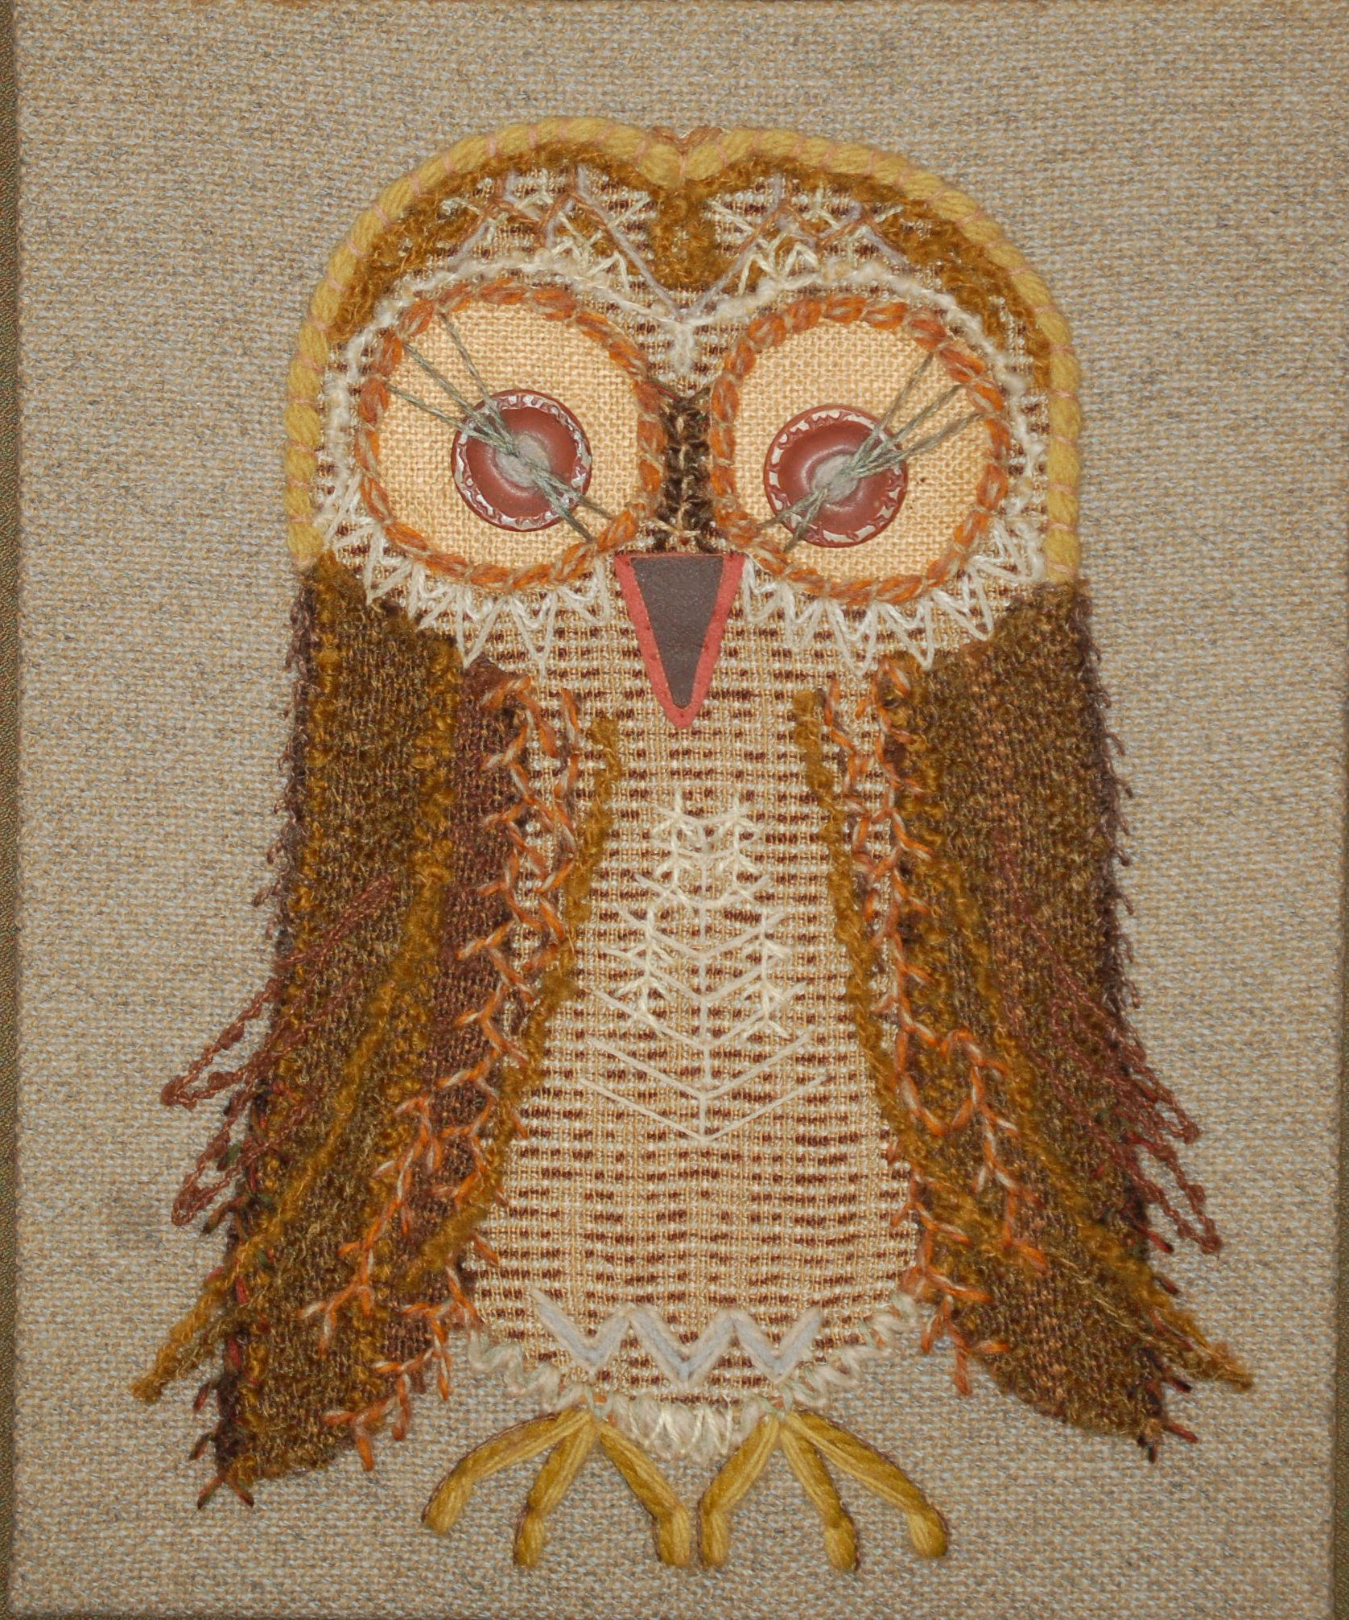

Slide 11
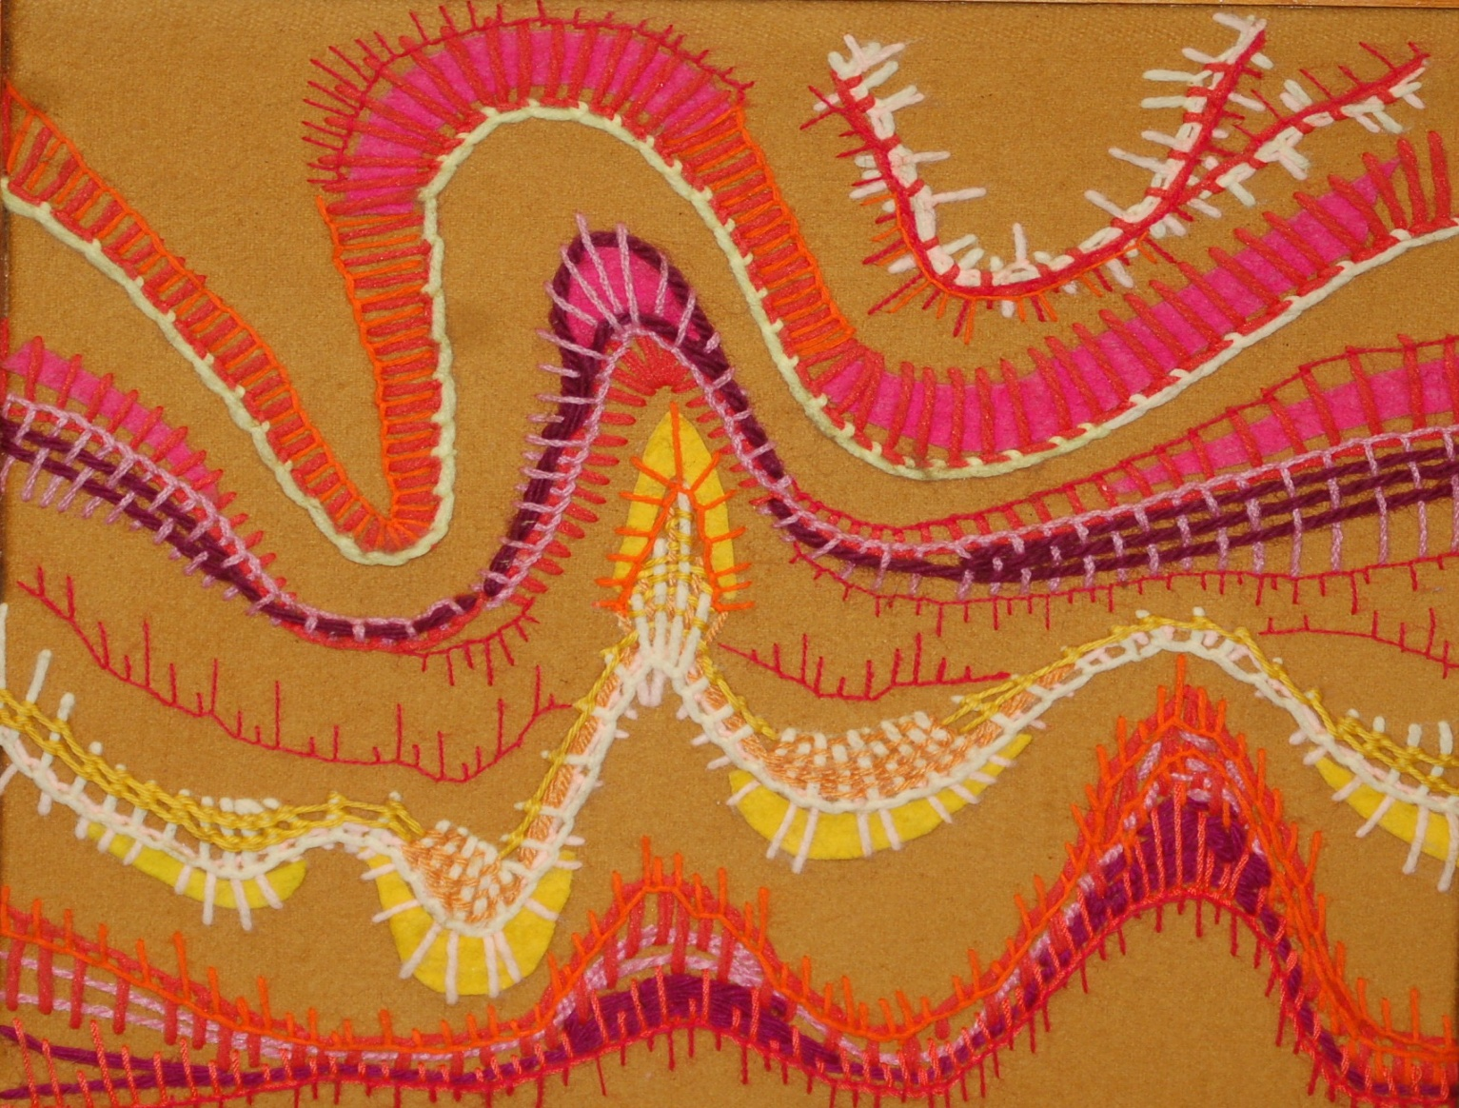
Stractic Interference

Slide 12
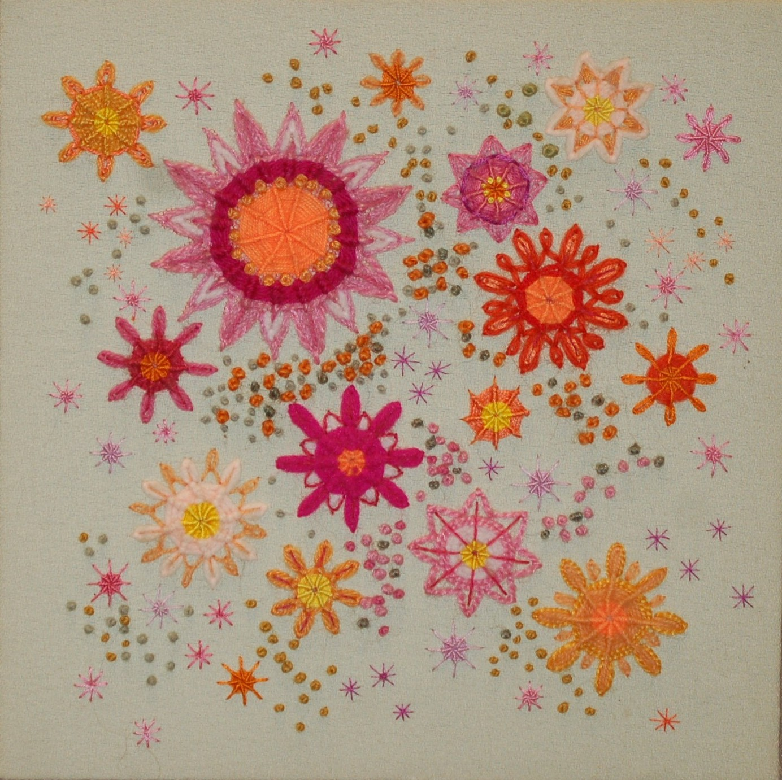

Slide 13
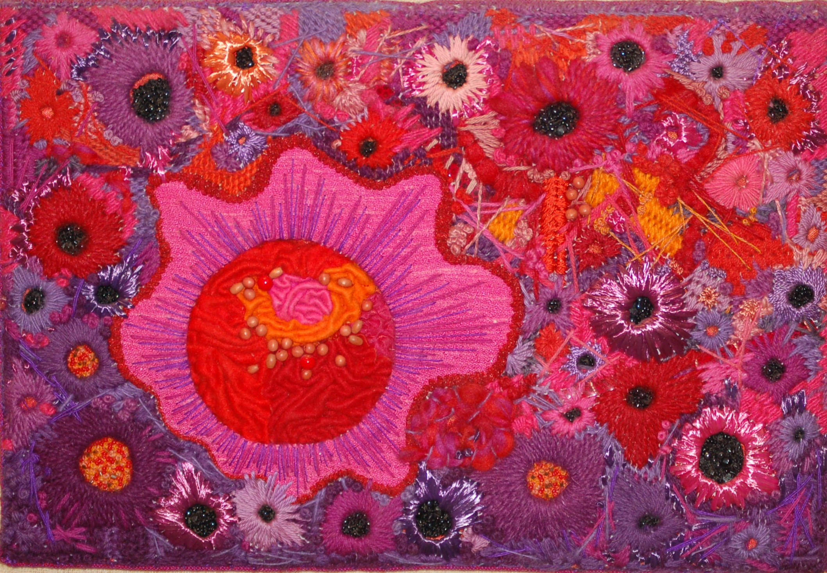

Slide 14
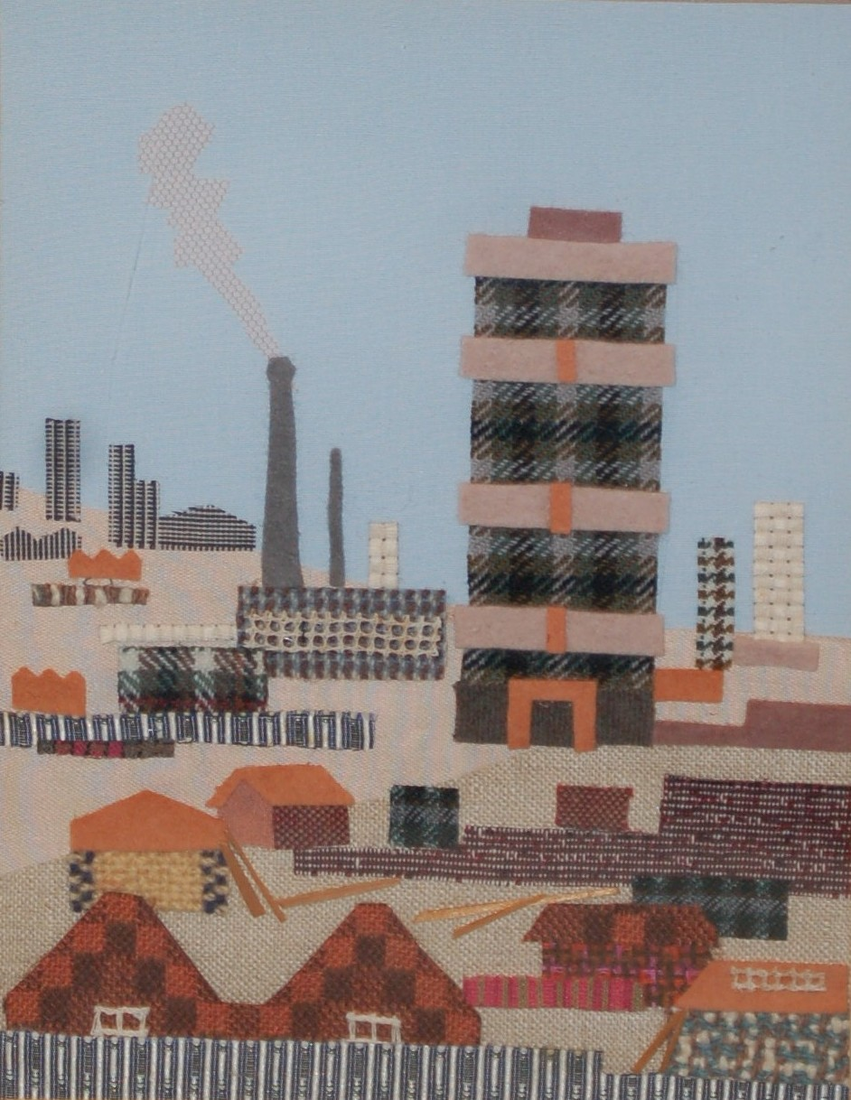

Slide 15
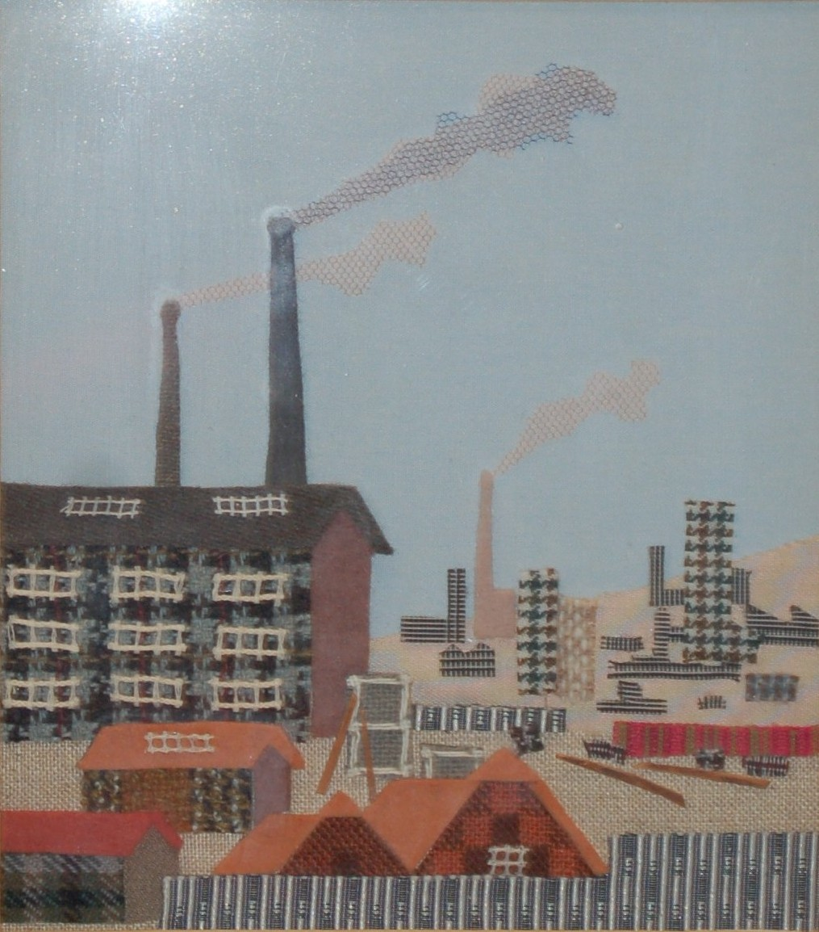

Slide 16
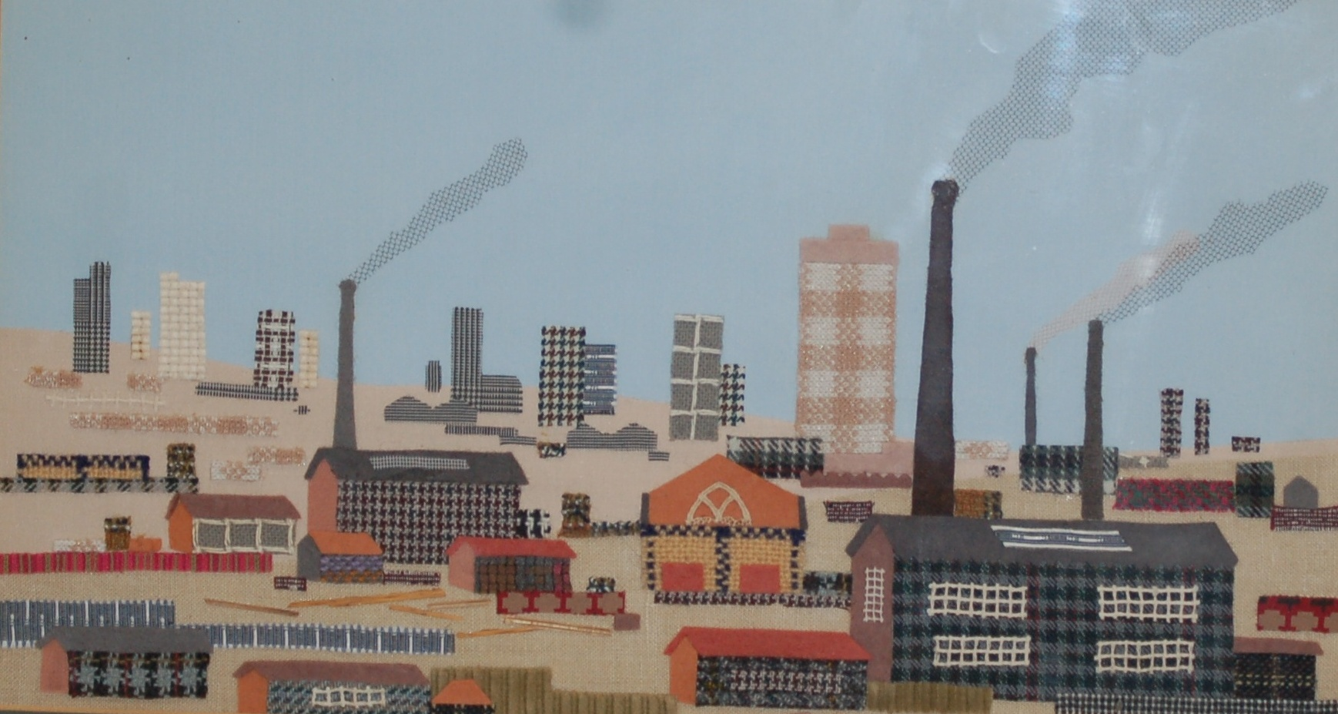

Slide 17
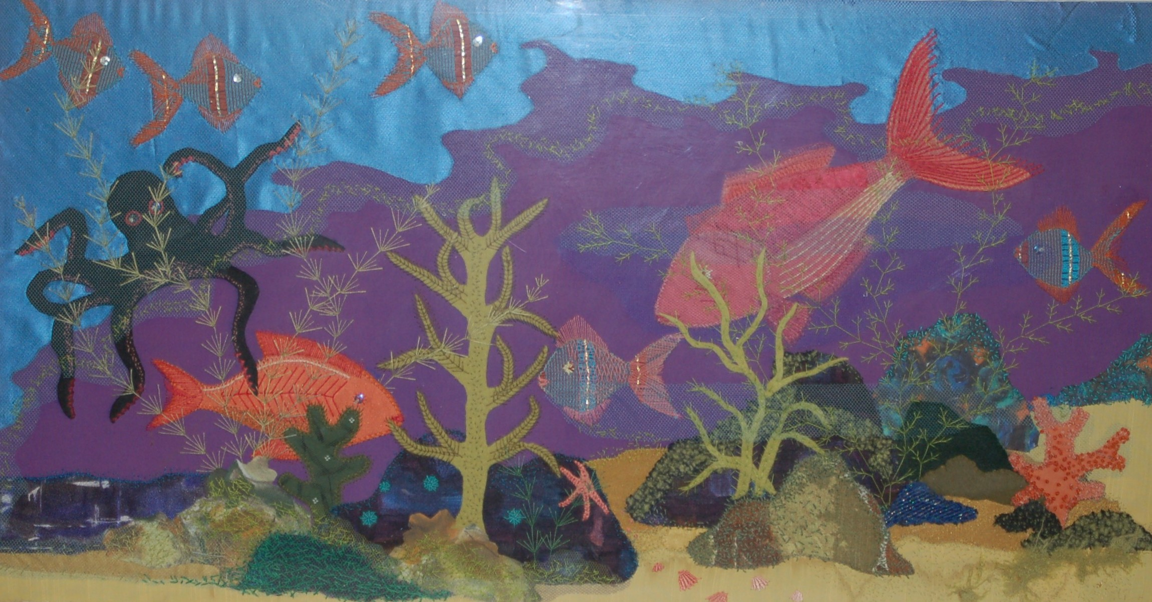
Aquamarine

Slide 18
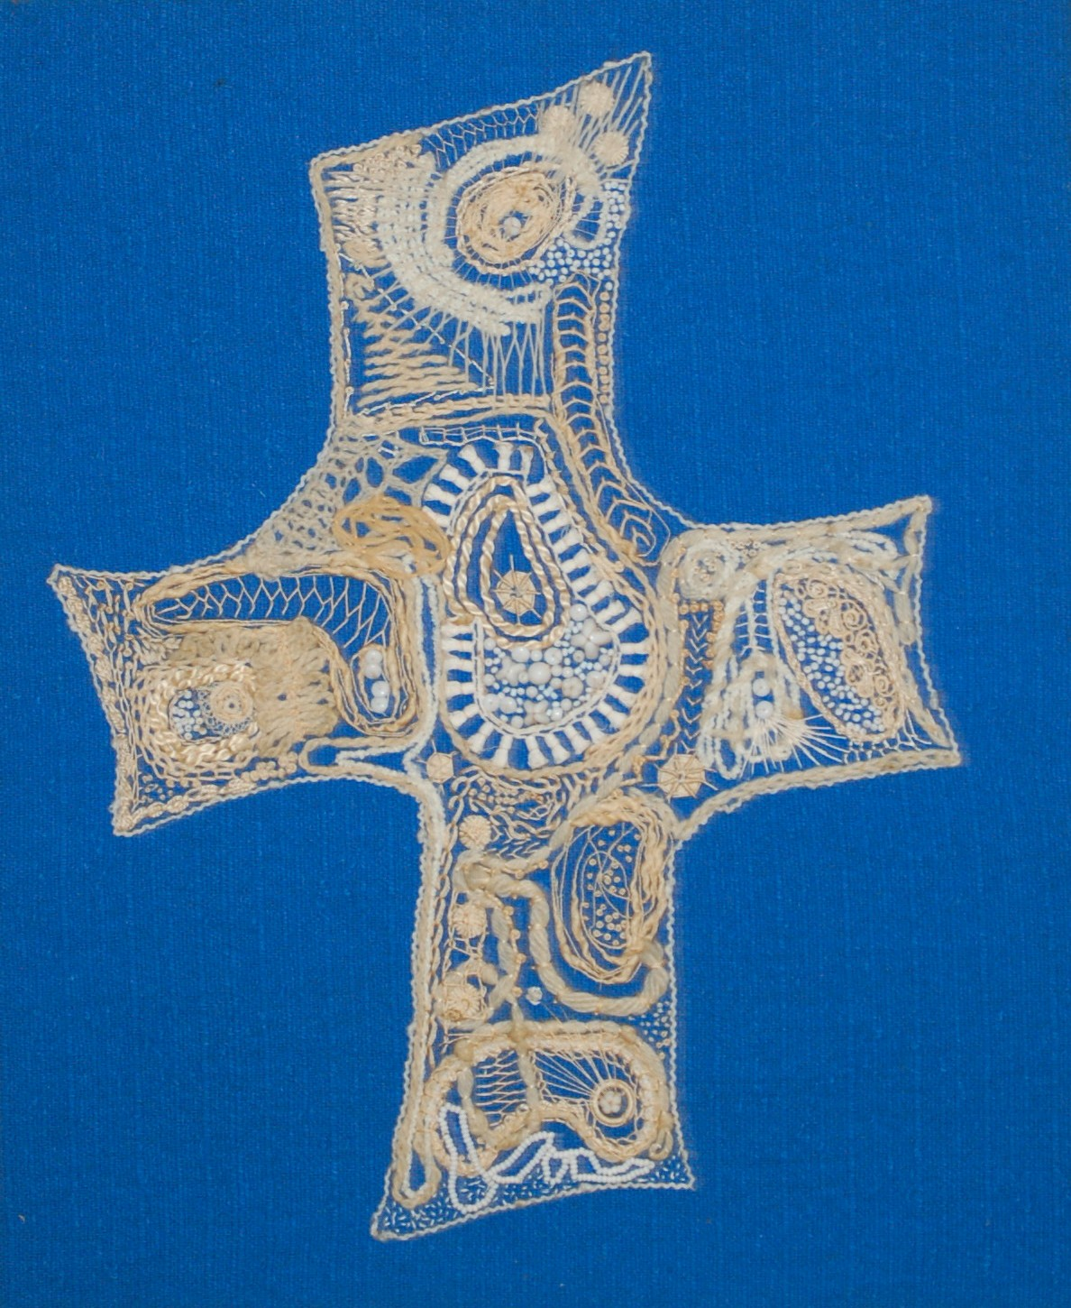

Slide 19
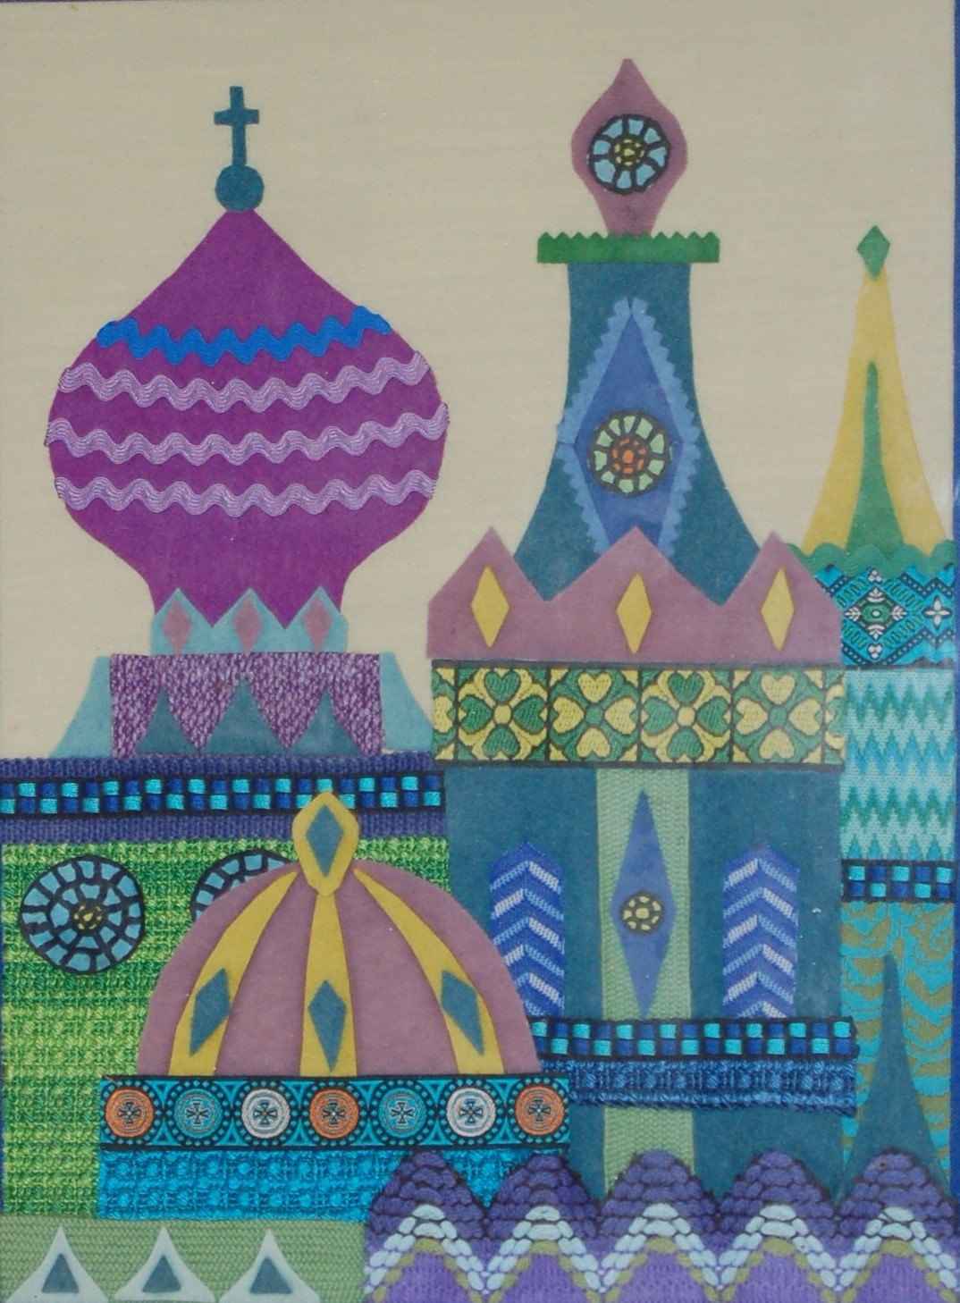
Blue Moscow

Slide 20
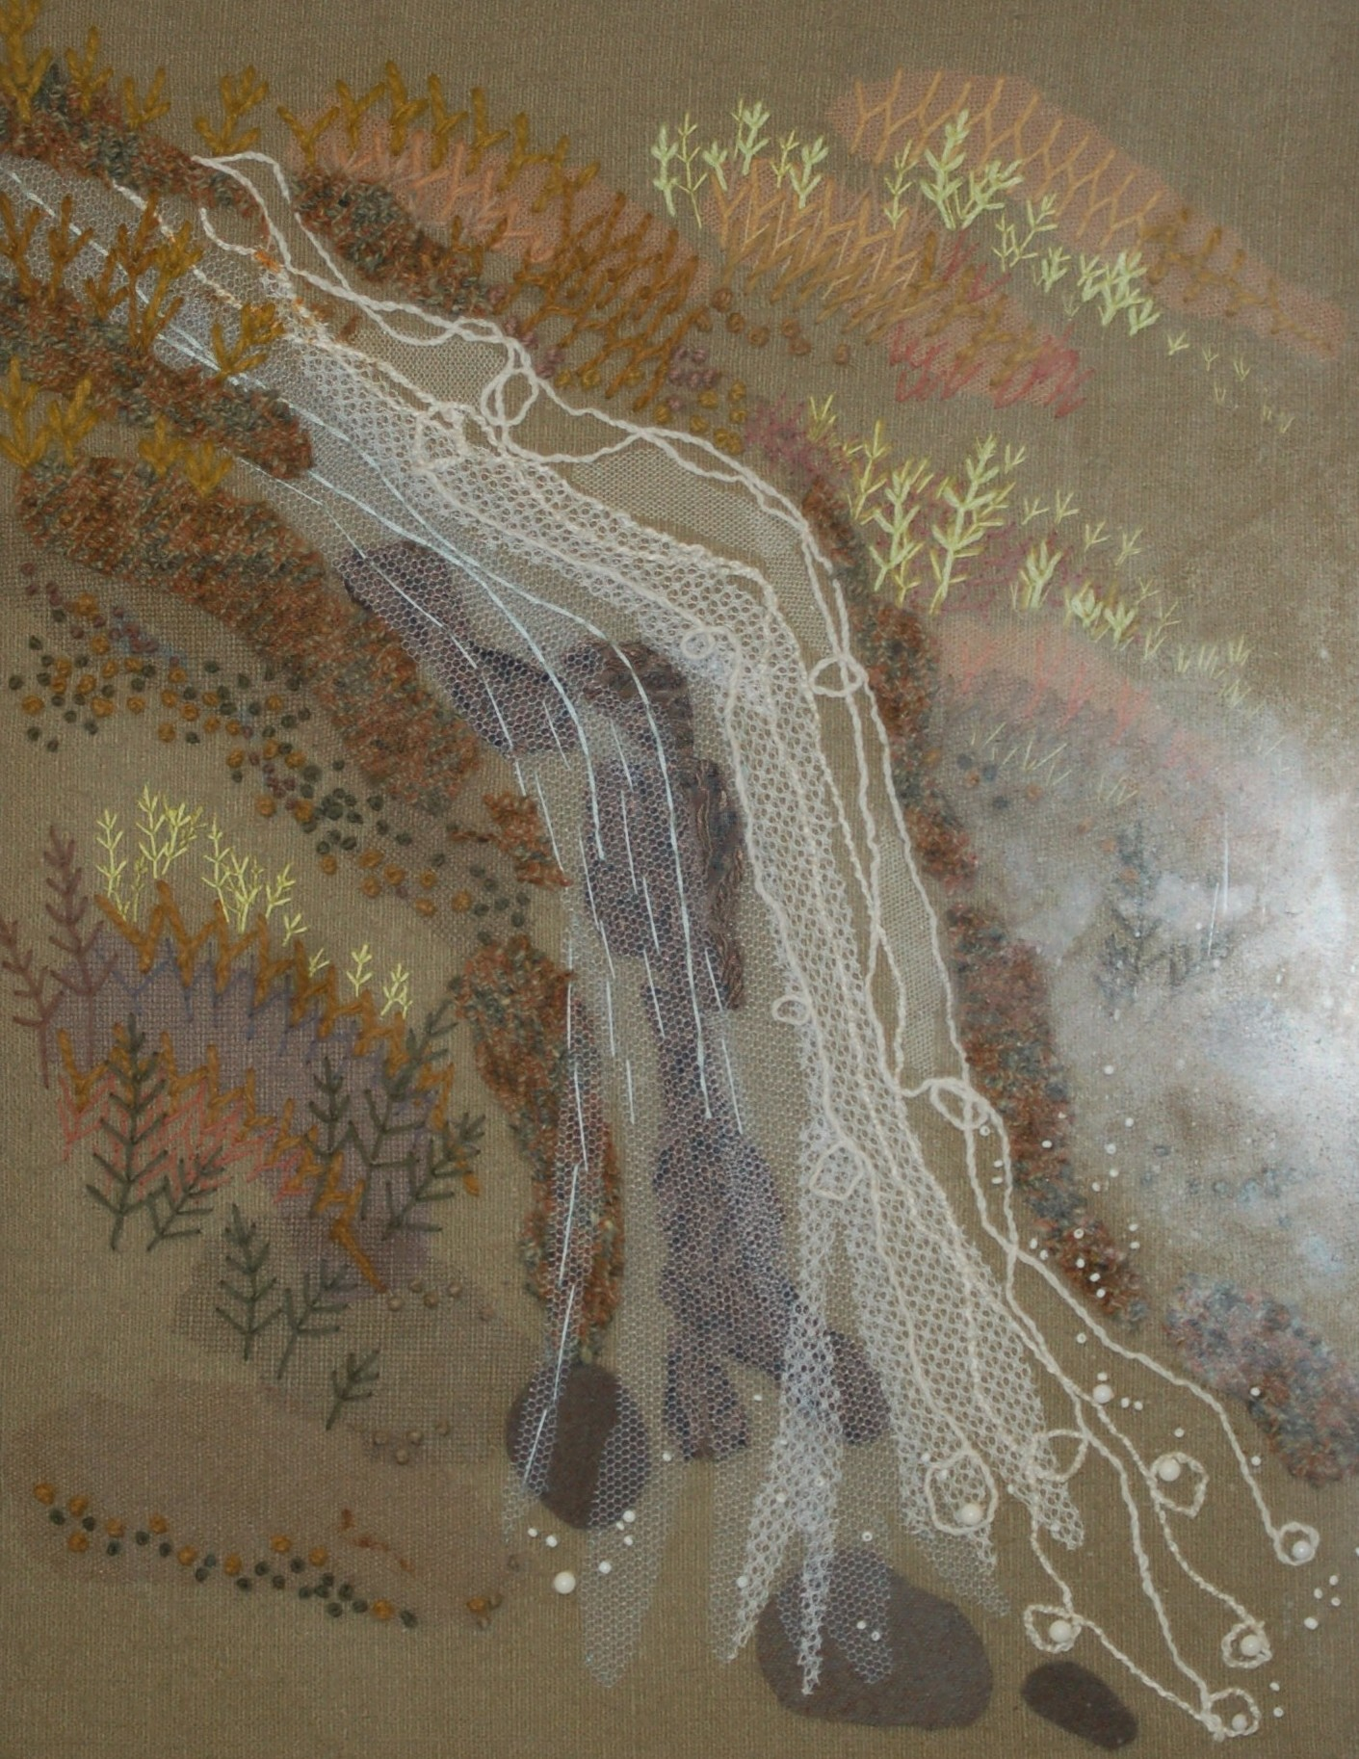
Waterfall

Slide 21
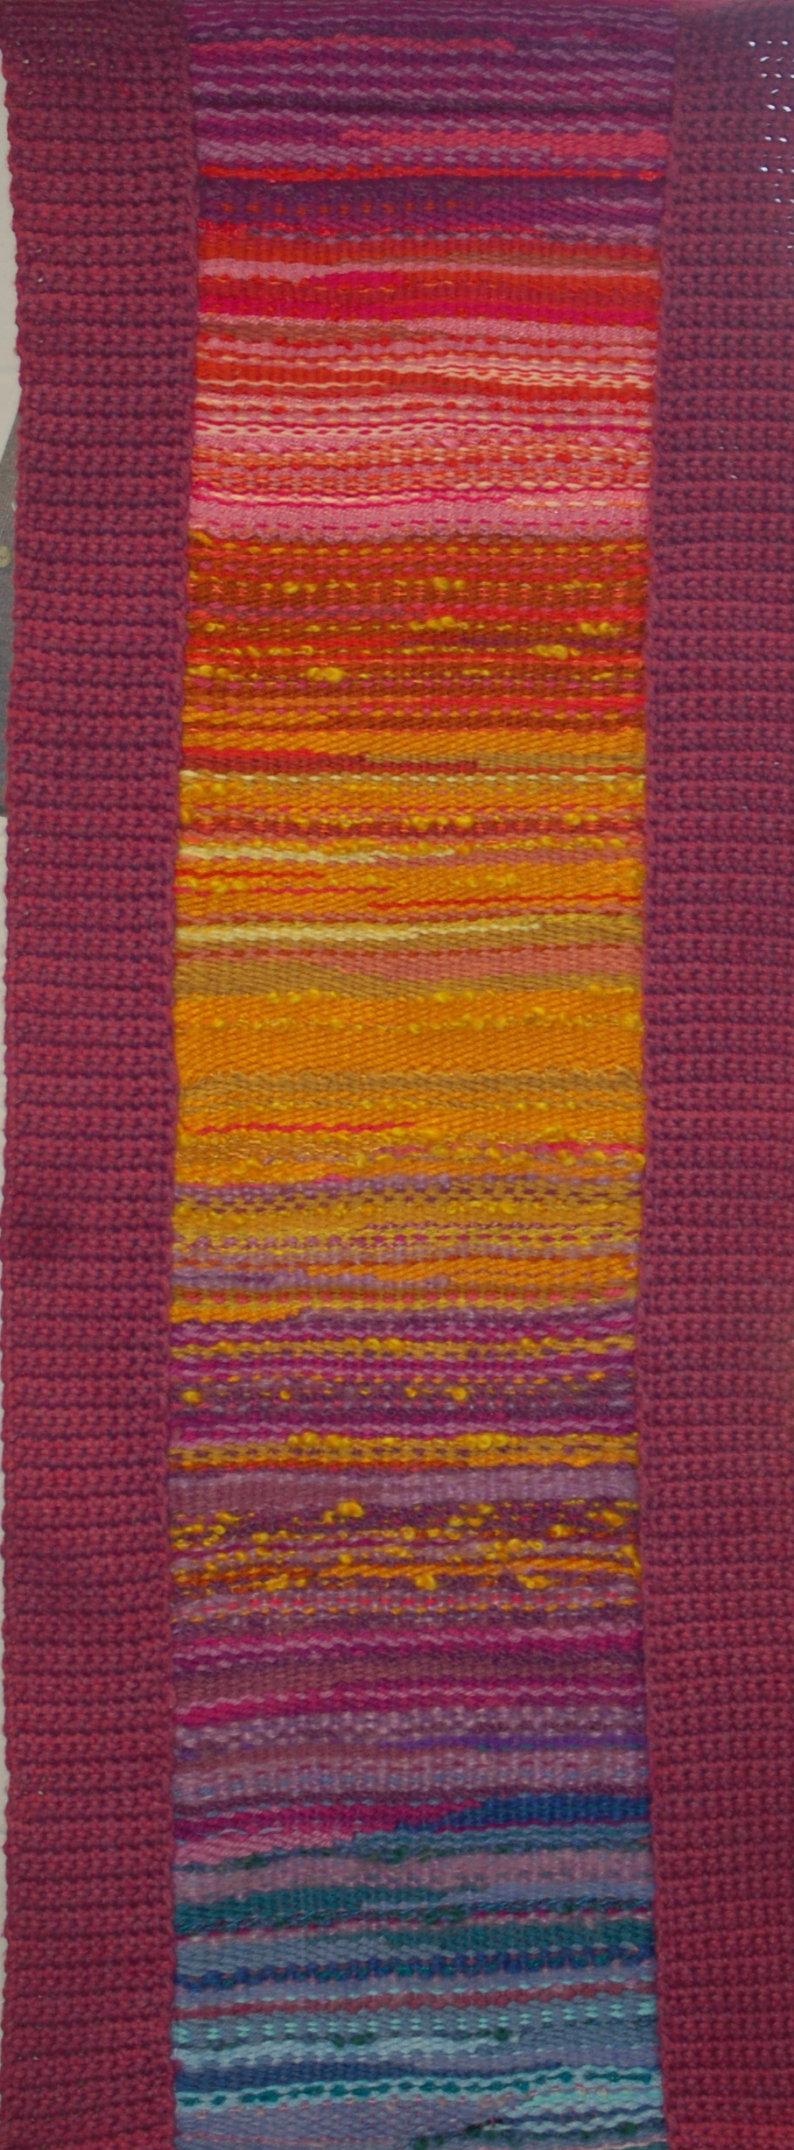

Slide 22
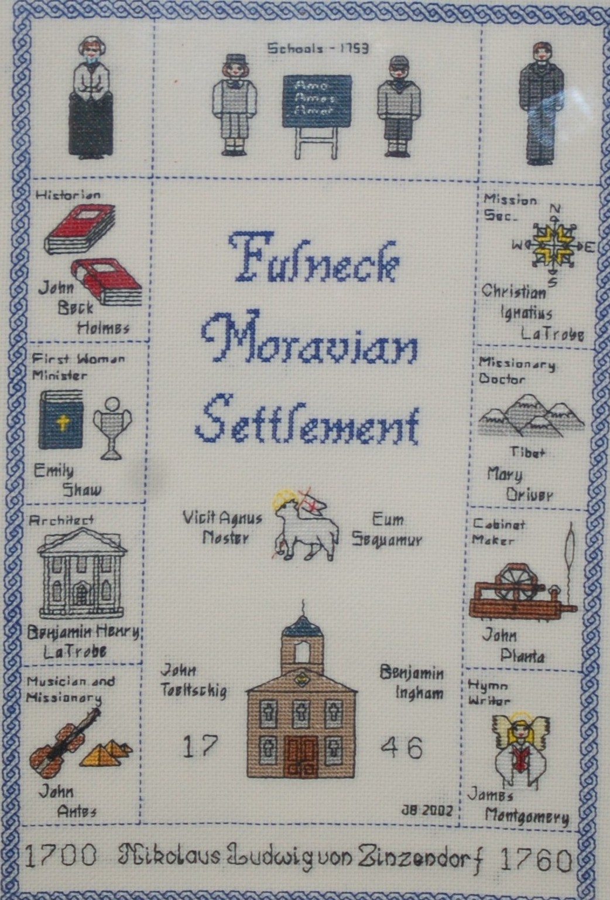
Heirloom

Slide 23
